Slide 1
Moving Forwards:
Healthy Travel for all in Cardiff and beyond
Dr Tom Porter Consultant in Public Health Medicine, Cardiff and Vale UHB / Public Health Wales
Cardiff University
4 Oct 2019

Slide 2
Context
Source: Moving Forwards (2017)

Slide 3
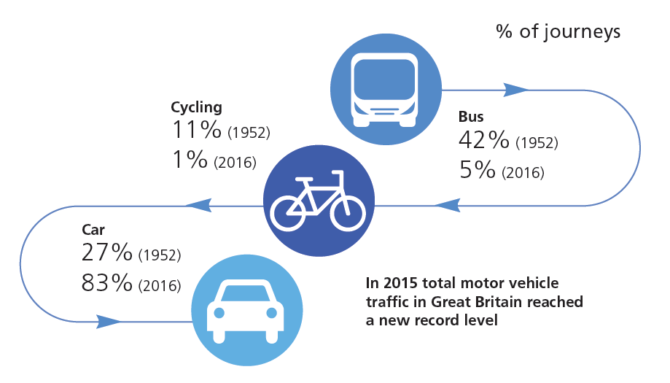
Travel has changed…

Slide 4
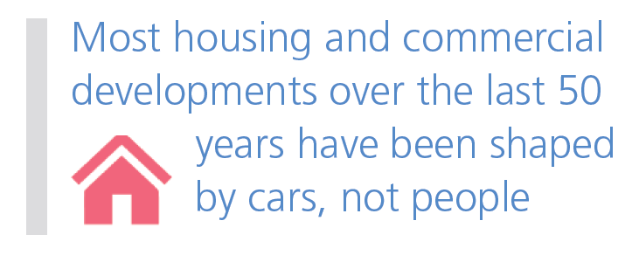
…and has changed our environment

Slide 5
…leading to multiple impacts on our health and wellbeing

Slide 6
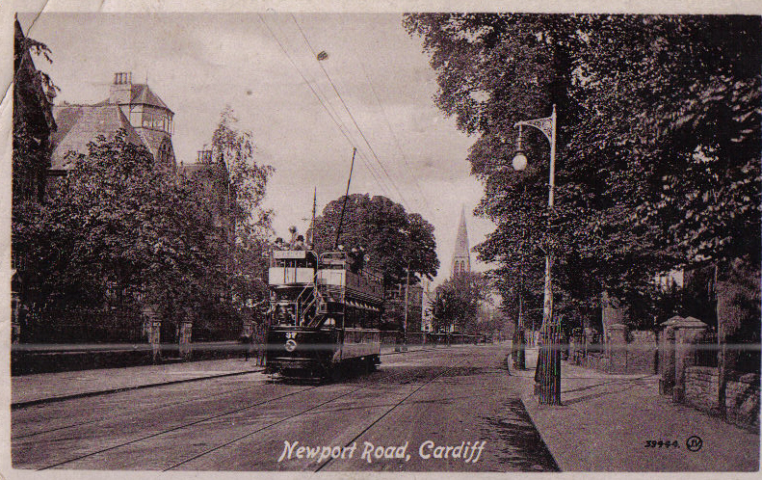

Slide 7
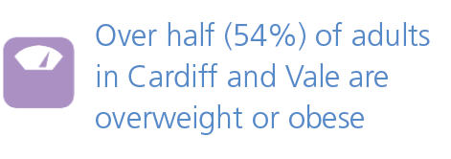
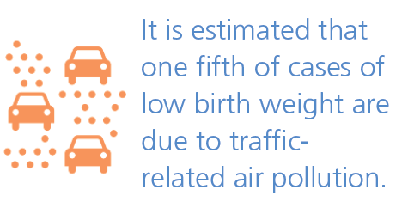

Slide 8
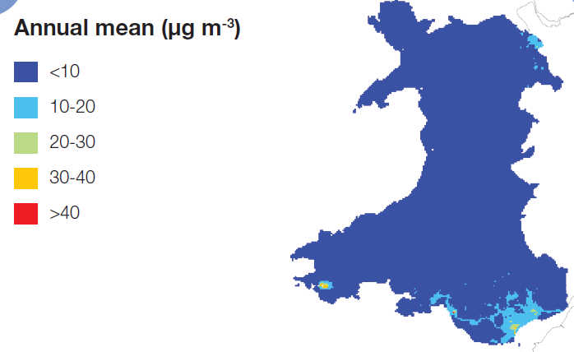

Slide 9
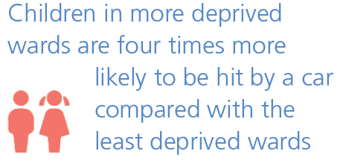
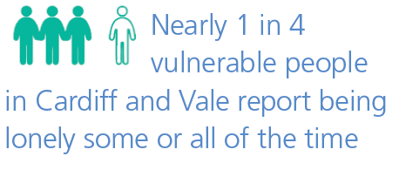
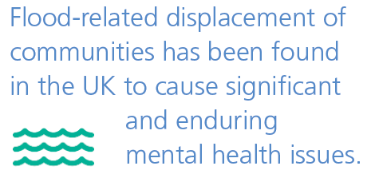

Slide 10
Source: Hart & Parkhurst (2011)

Slide 11
Source: Welsh Government/UKCCC

Slide 12
We could do things differently

Slide 13
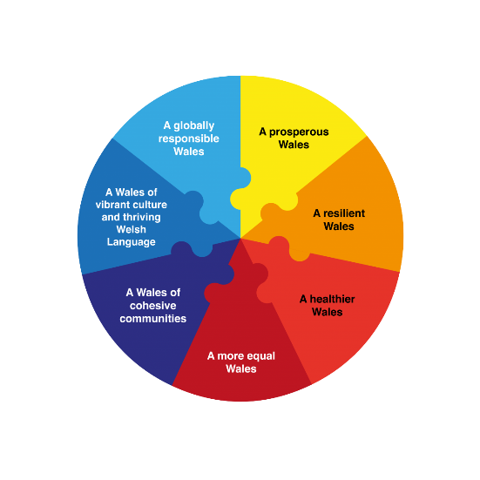
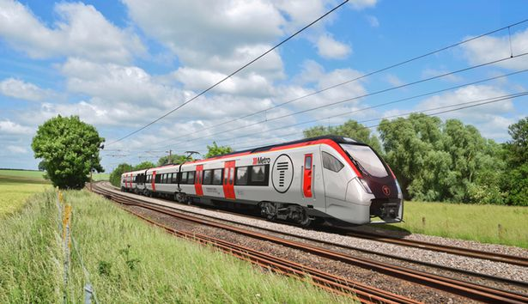
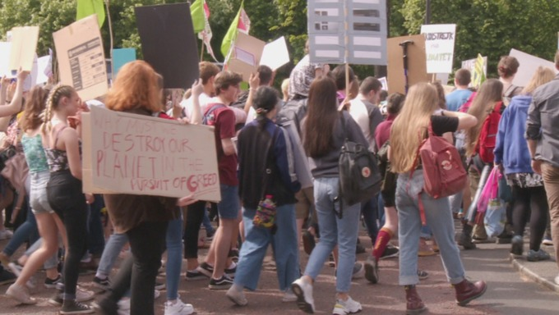
The time is right for change…

Slide 14
The potential impact

Slide 15
Beware shiny EVs
Source: European Parliament (2019)

Slide 16
We can be ambitious
Source: Propensity to Cycle tool

Slide 17
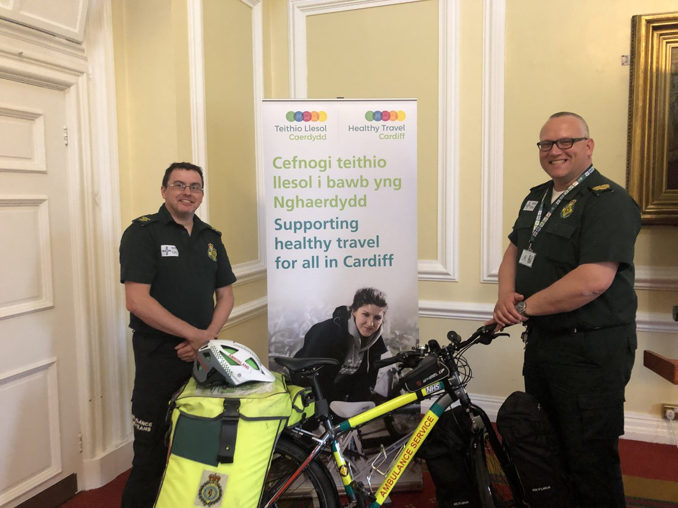
Leadership is vital

Slide 18
Progress in Cardiff

Slide 19
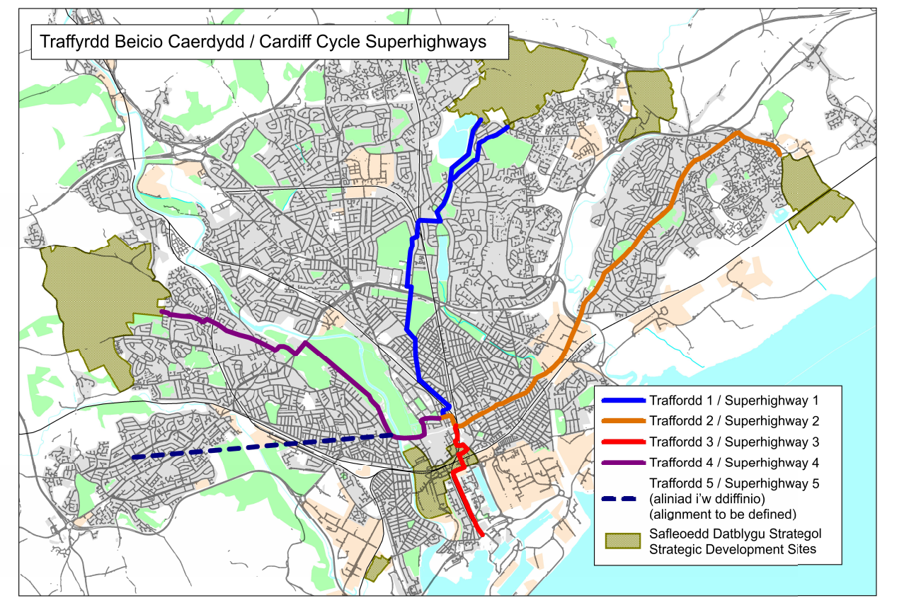
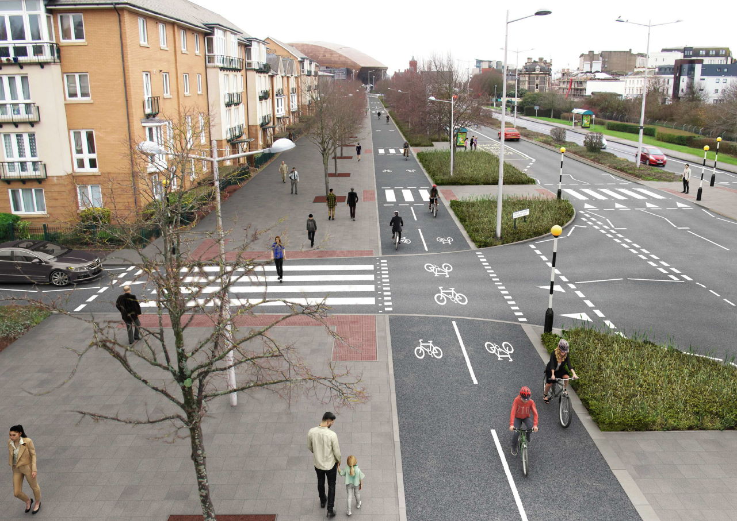
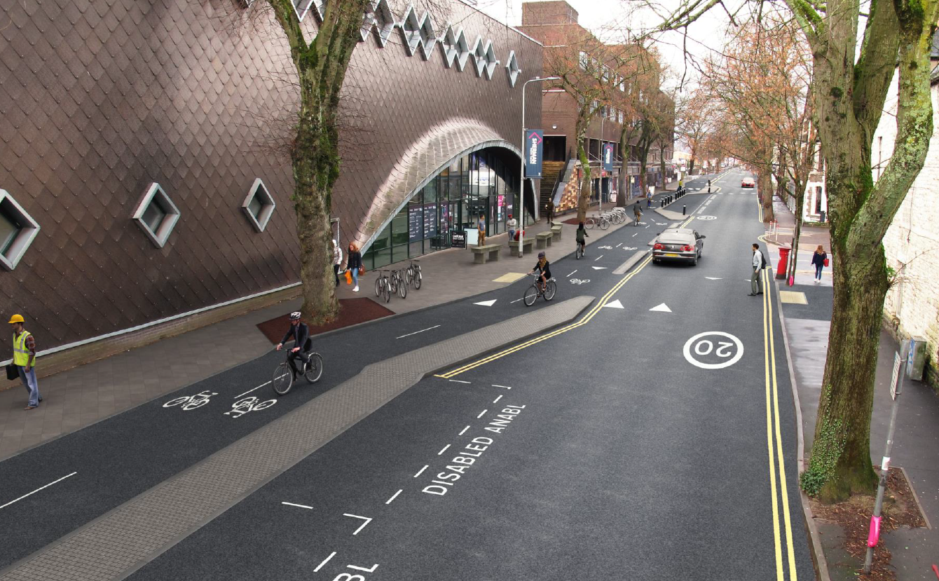
Cycleways
Clean air plan
Car free day
Street play
20mph locally and Wales policy

Slide 20
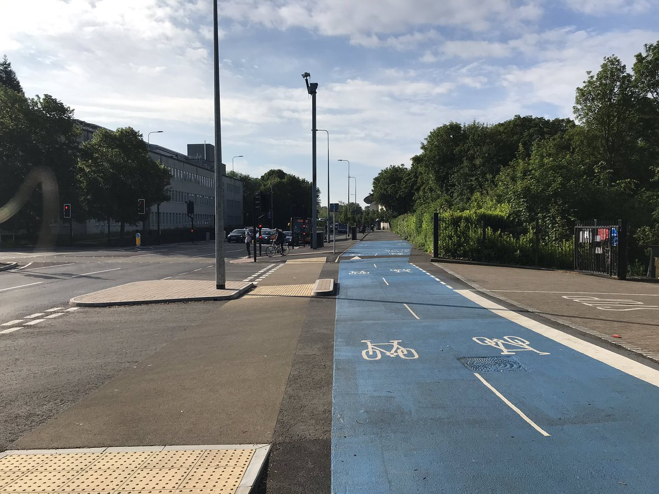

Slide 21
Nextbike cycle hire
In first year…
50 stations, 500 bikes
5-10,000 rentals per week
>50,000 registered
Quickest growing scheme in UK
Further expanding, incl. more stations, bikes and e-bikes

Slide 22
Clean air plan (pending WG approval)

Slide 23
Clean air plan (pending WG approval)
Package measures
Active travel measures – 20mph zones, Cycleway 1
Electric buses x 36
Retrofit 80% remaining buses
Taxi licensing – all renewals Euro VI; grant for plug-in hybrid/BEV
City Centre transport schemes inc. Castle Street
Air quality improvements
327,000 people est. to experience cleaner air
Effect larger in more deprived communities
Castle Street modelled to reduce by 10µg – well within legal limits

Slide 24
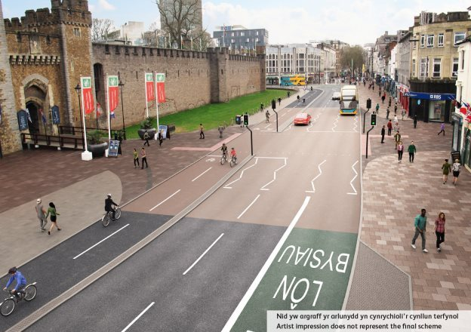

Slide 25
Healthy travel Charter

Slide 26
14
3
Commitments over 3 years
High level targets
Supporting…
Walking and cycling
Public transport
Ultra low emission vehicle use

Slide 27
Improved air quality
Healthier, happier, more productive staff
Reduced CO₂ emissions
Reduced health inequalities

Slide 28
15
Organisations (and counting!)
>33,000
Cardiff-based staff

Slide 29
Who we are
From 7…
to 15!

Slide 30
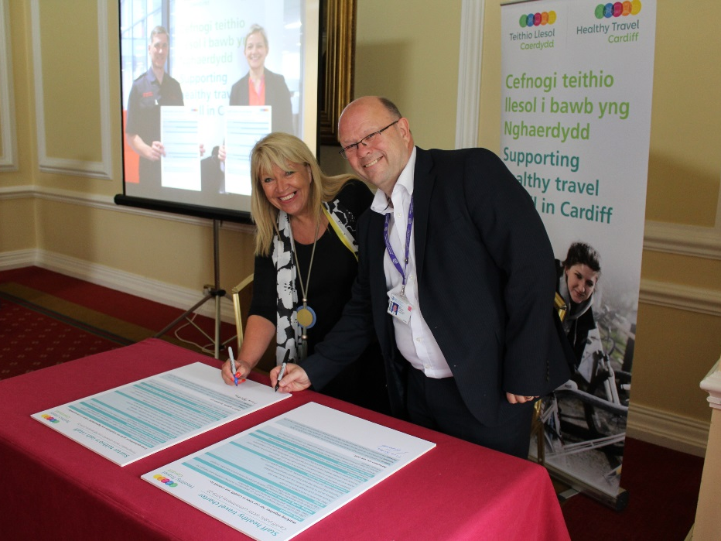
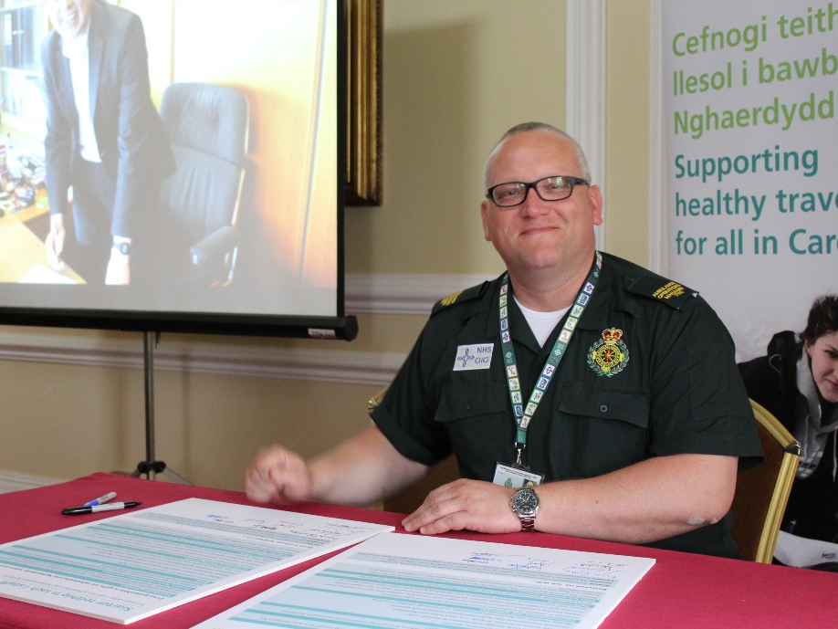
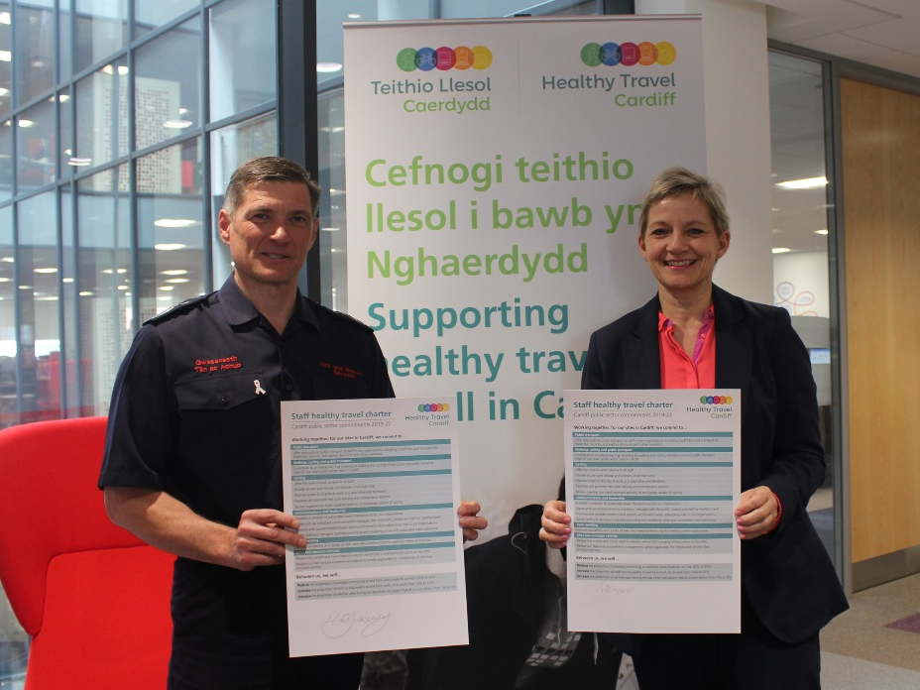

Slide 31
Charter – next steps
Implementation
Monitoring and sharing progress, working jointly
Repeat staff survey annually
Develop Charter versions with and for…
Private sector (with Cardiff Business Improvement District, other major employers)
Vale of Glamorgan Council, other neighbouring authorities and beyond
Third sector

Slide 32
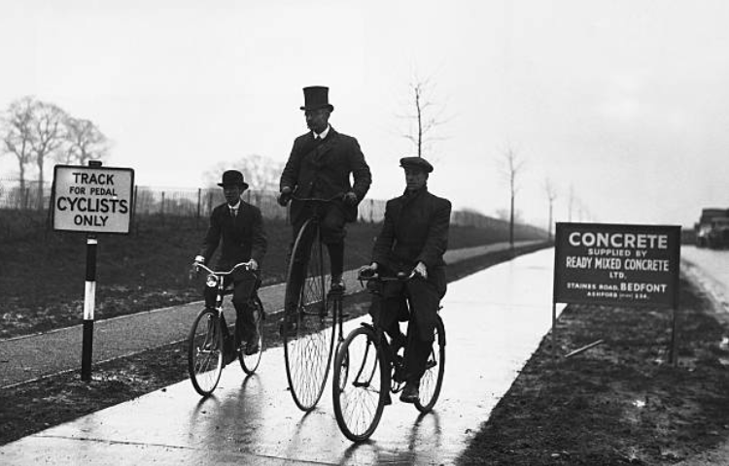
Back to the future…
London-Brighton highway
Britain’s first cycle way (1934)
Source: Bikeboom.info

Slide 33
Summary
Built environment and behaviours of those around us fundamentally shapes our behaviour
Multiple adverse impacts of car dependency on health and its wider determinants
This can be changed - we know what to do
Takes leadership at all levels

Slide 34
Thank you
Diolch
tom.porter@wales.nhs.uk

